Slide 1
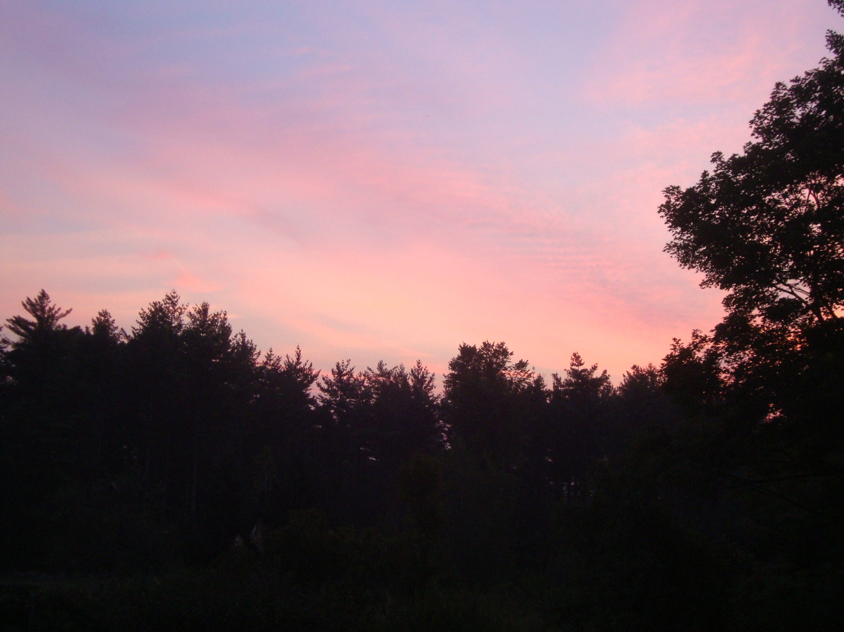
Maples on Bald Mt May 27, 2010: Argument for More Citizen Scientists
Martha Carlson on Dr. Henry Parker’s farm, Campton, NH.

Slide 2
Weather on May 26
92-93º F, Campton, U.S. Forest Service headquarters.
Wind North to Northwest.
No clouds
Pine pollen chuffing off trees like smoke.
Channel 9 reports 96º in Lebanon.
The sky has a blue glint typical of high level O₃ days.
Eighty-six fires in Quebec burn 750 sq. km., smoke causing haze and odor in Montreal and New England.

Slide 3
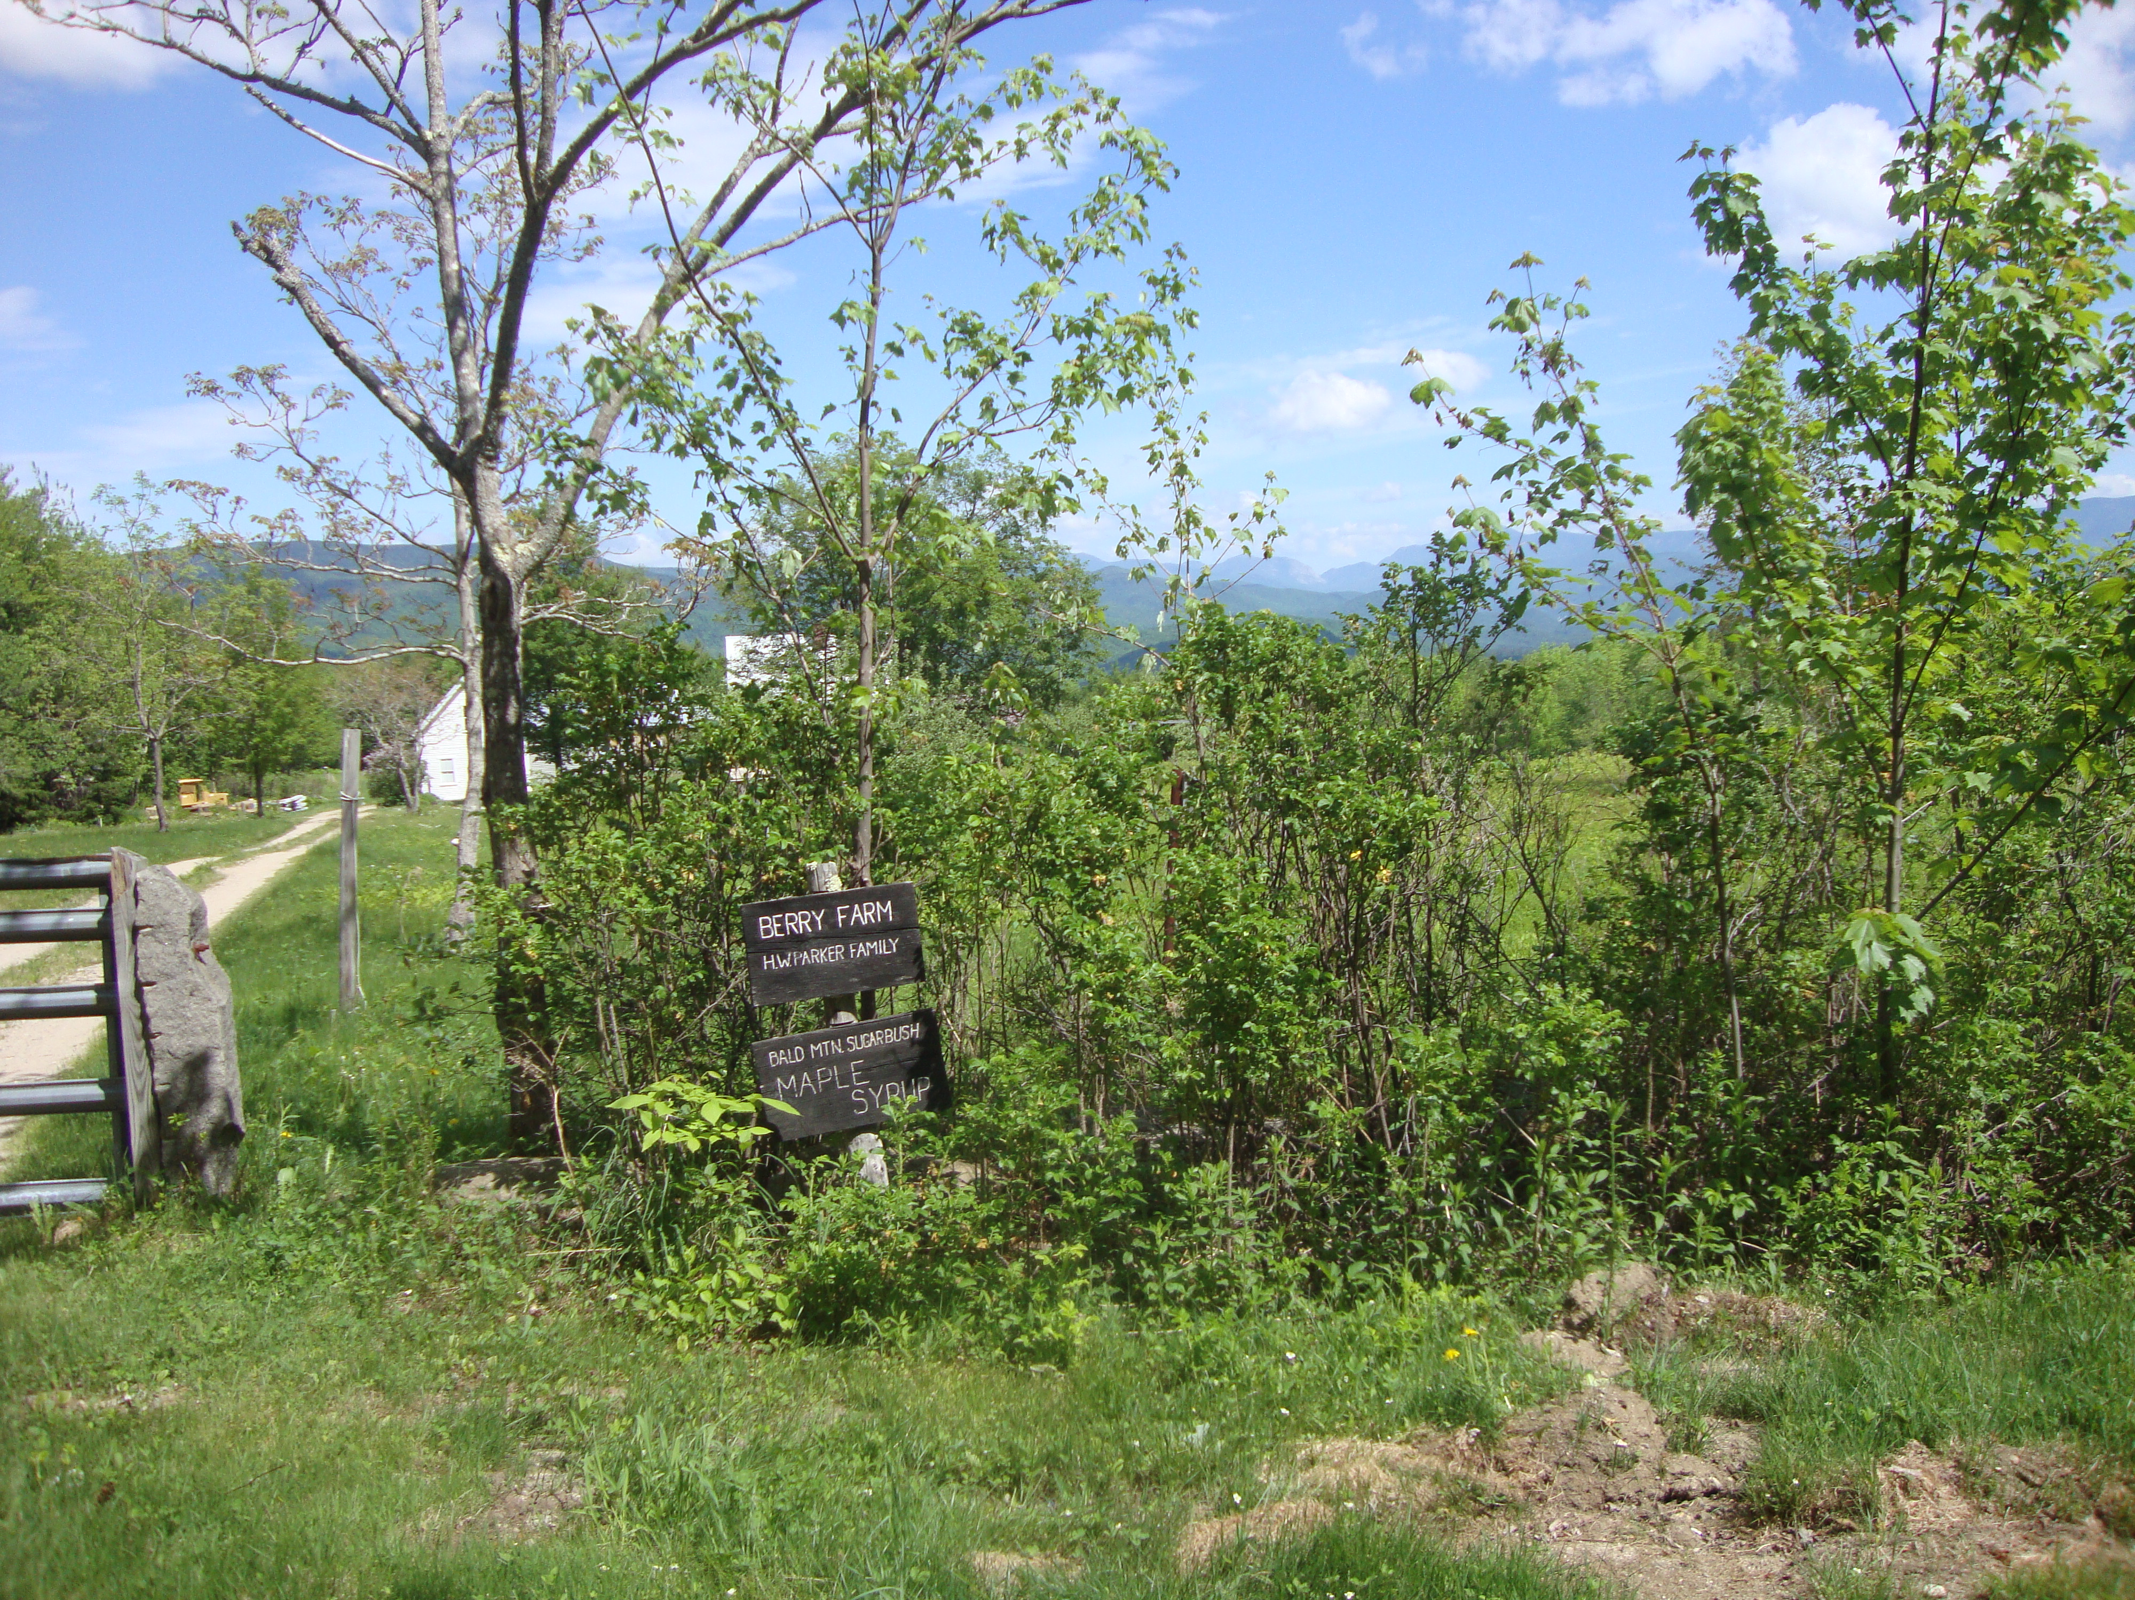
May 27, Campton, NH
Berry Farm looking north to Cannon Mt. and Franconia Notch.1600 feet.

Slide 4
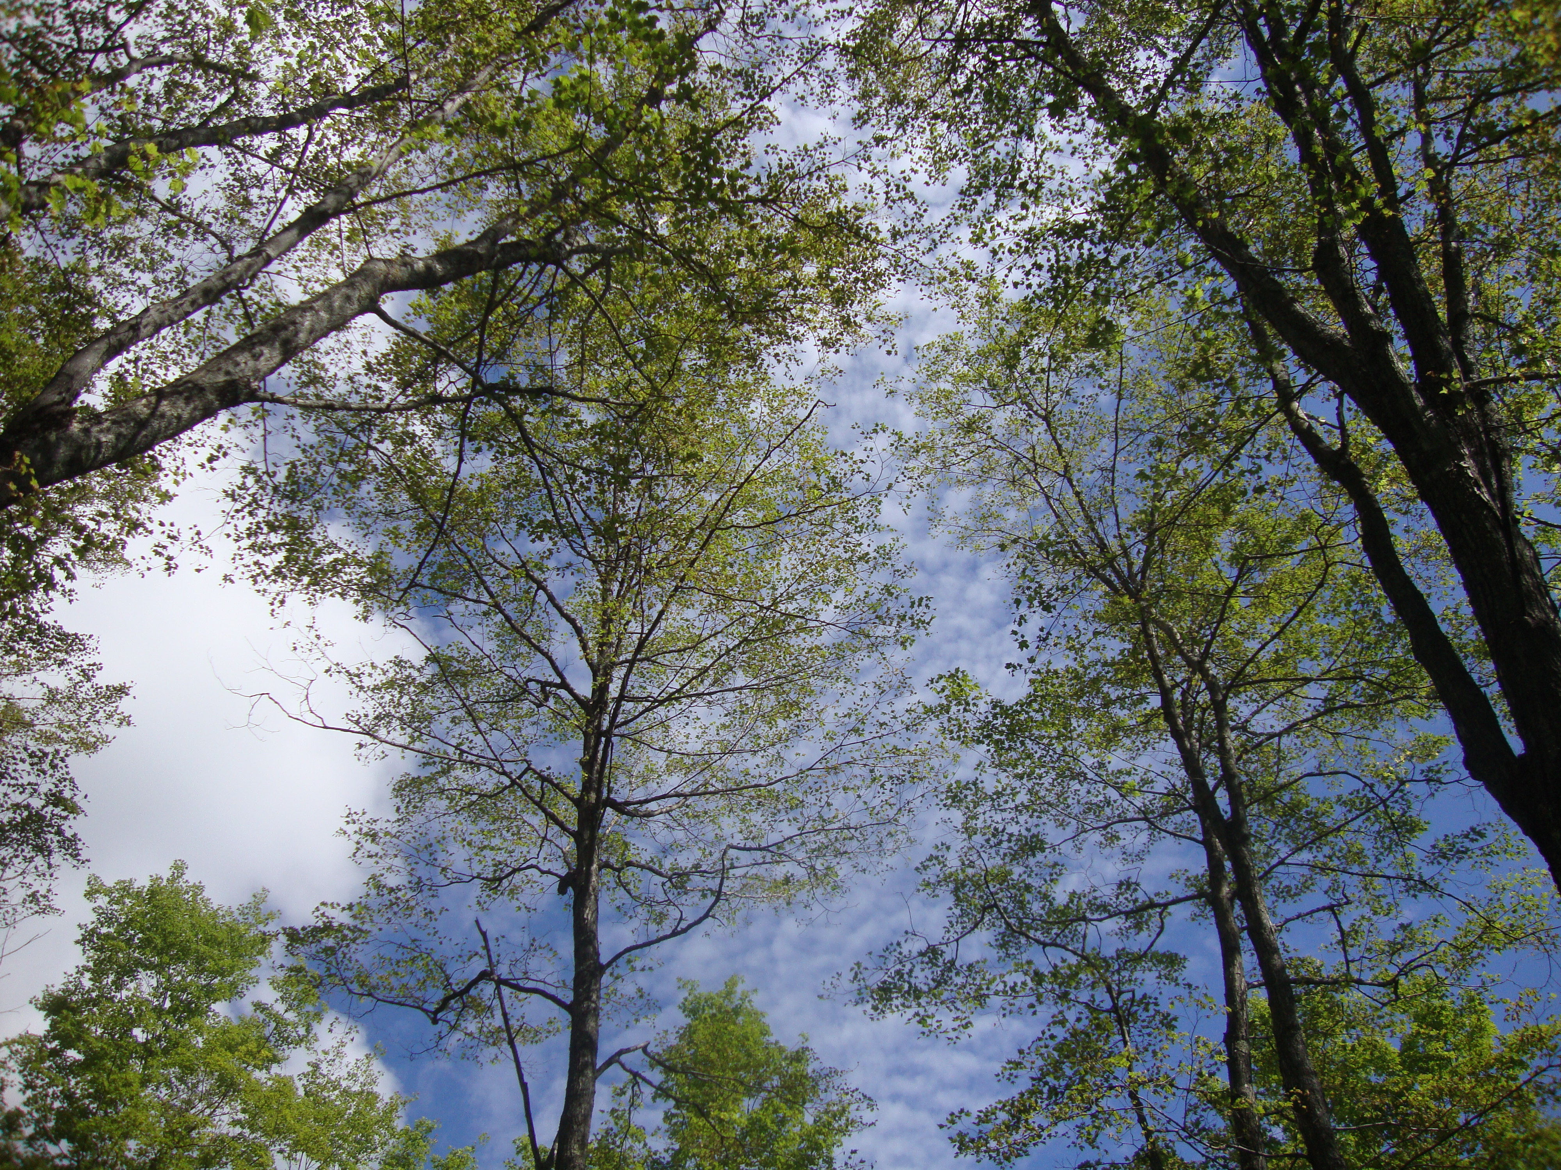
First Cellar Hole, 1809 ft.
We notice canopy looks unusually thin.

Slide 5
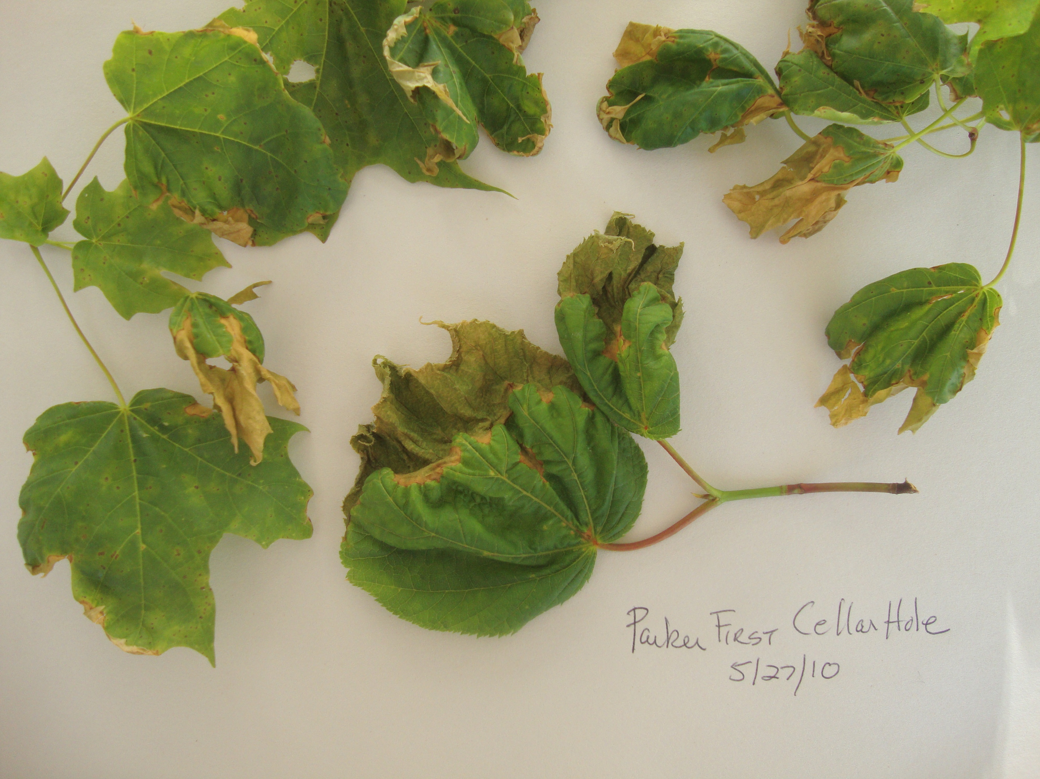
Leaf Samples, Tree 856
Tips of leaves appear to have been dipped in gold paint.
Leaves are withering.

Slide 6
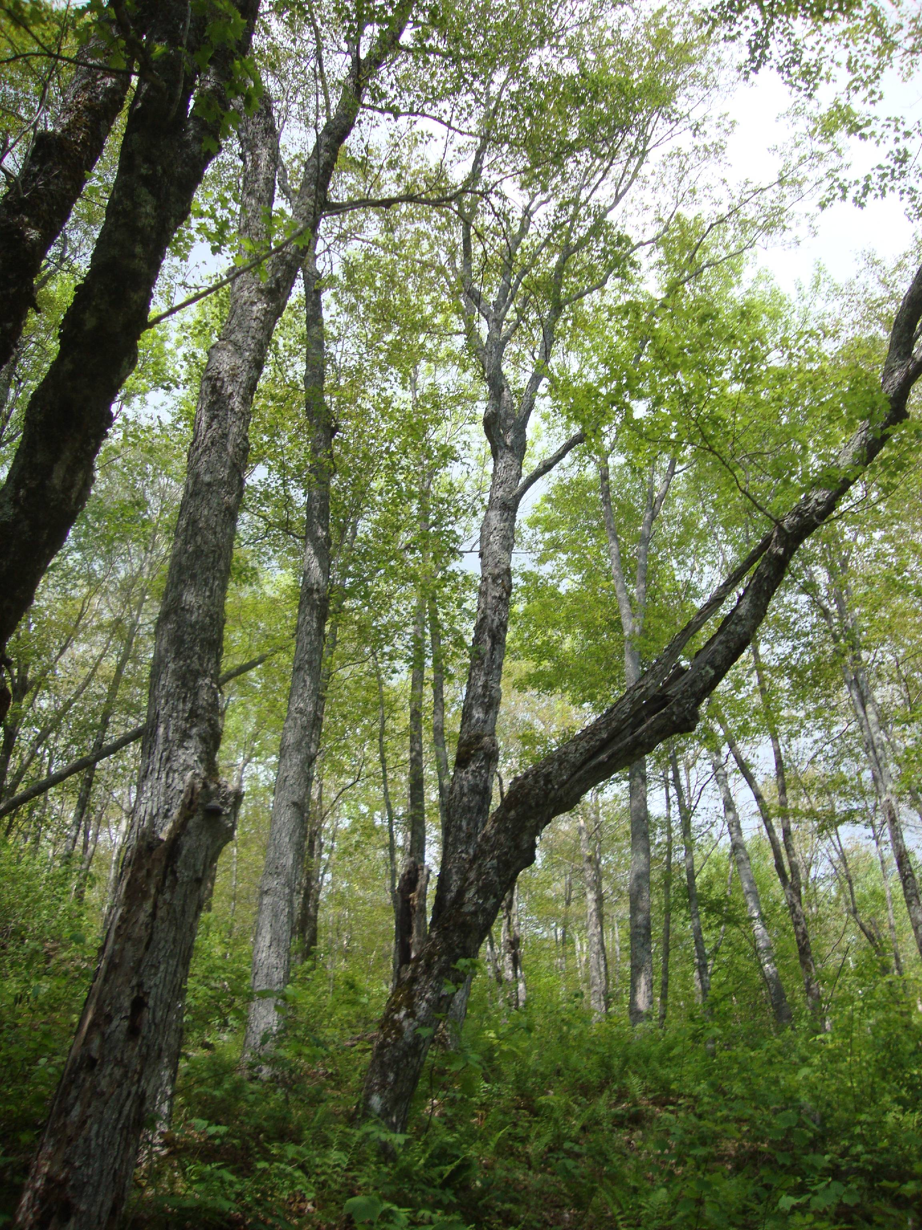
Climbing Higher
As we climbed, the canopy became thinner among the maples. Ash, Fraxinus pennsylvanica., and yellow birch, Betula allegheniensis, did not appear to be affected.

Slide 7
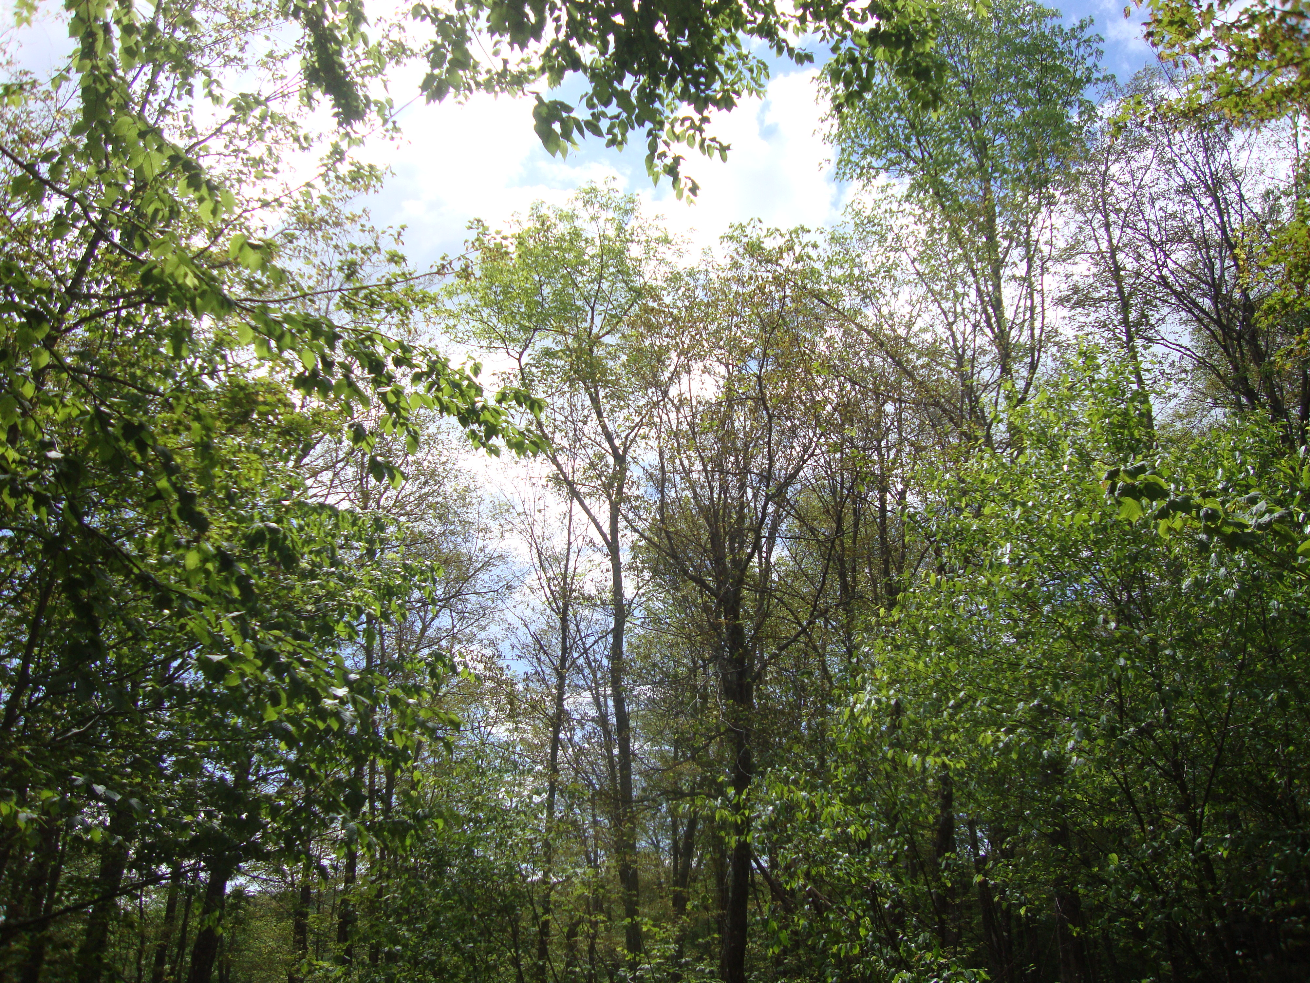
Second Cellar Hole, 1840 feet
At 1840 ft., maple canopy was thin and had a visible brownish tinge.

Slide 8
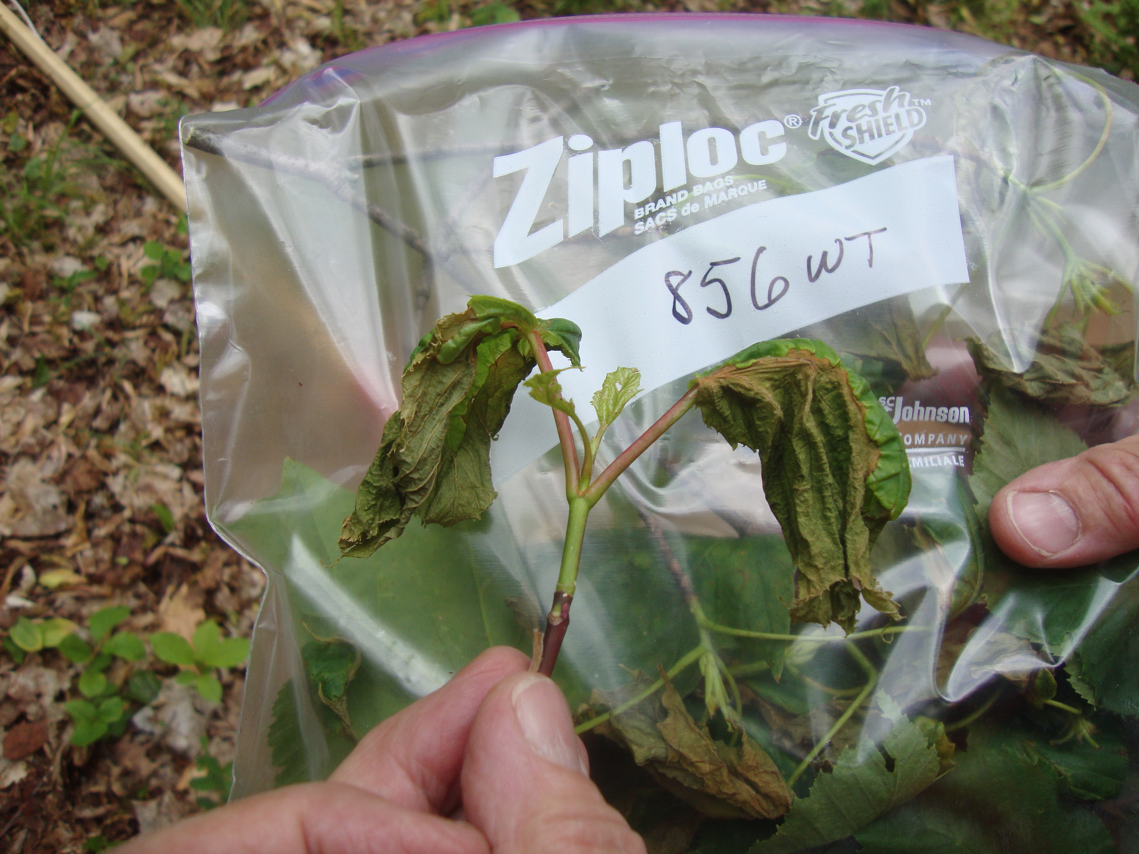
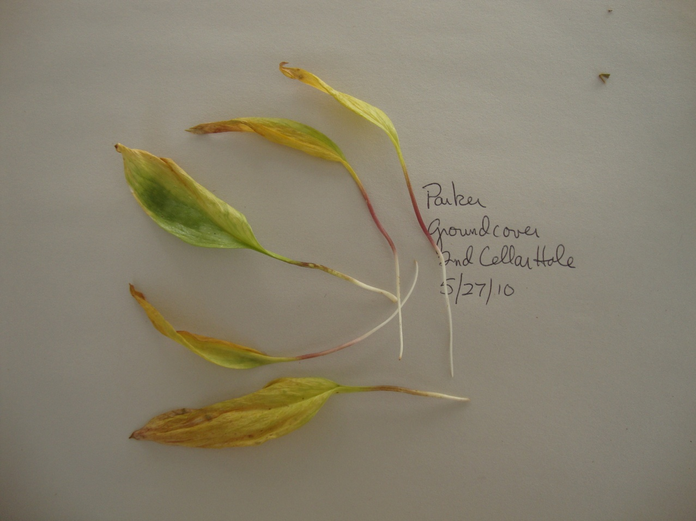
Greater damage to more trees
Almost total leaf involved in damage.
Damage seen on moose maple and some tender groundcover leaves.
Canada mayflower, Maianthemum canadense.

Slide 9
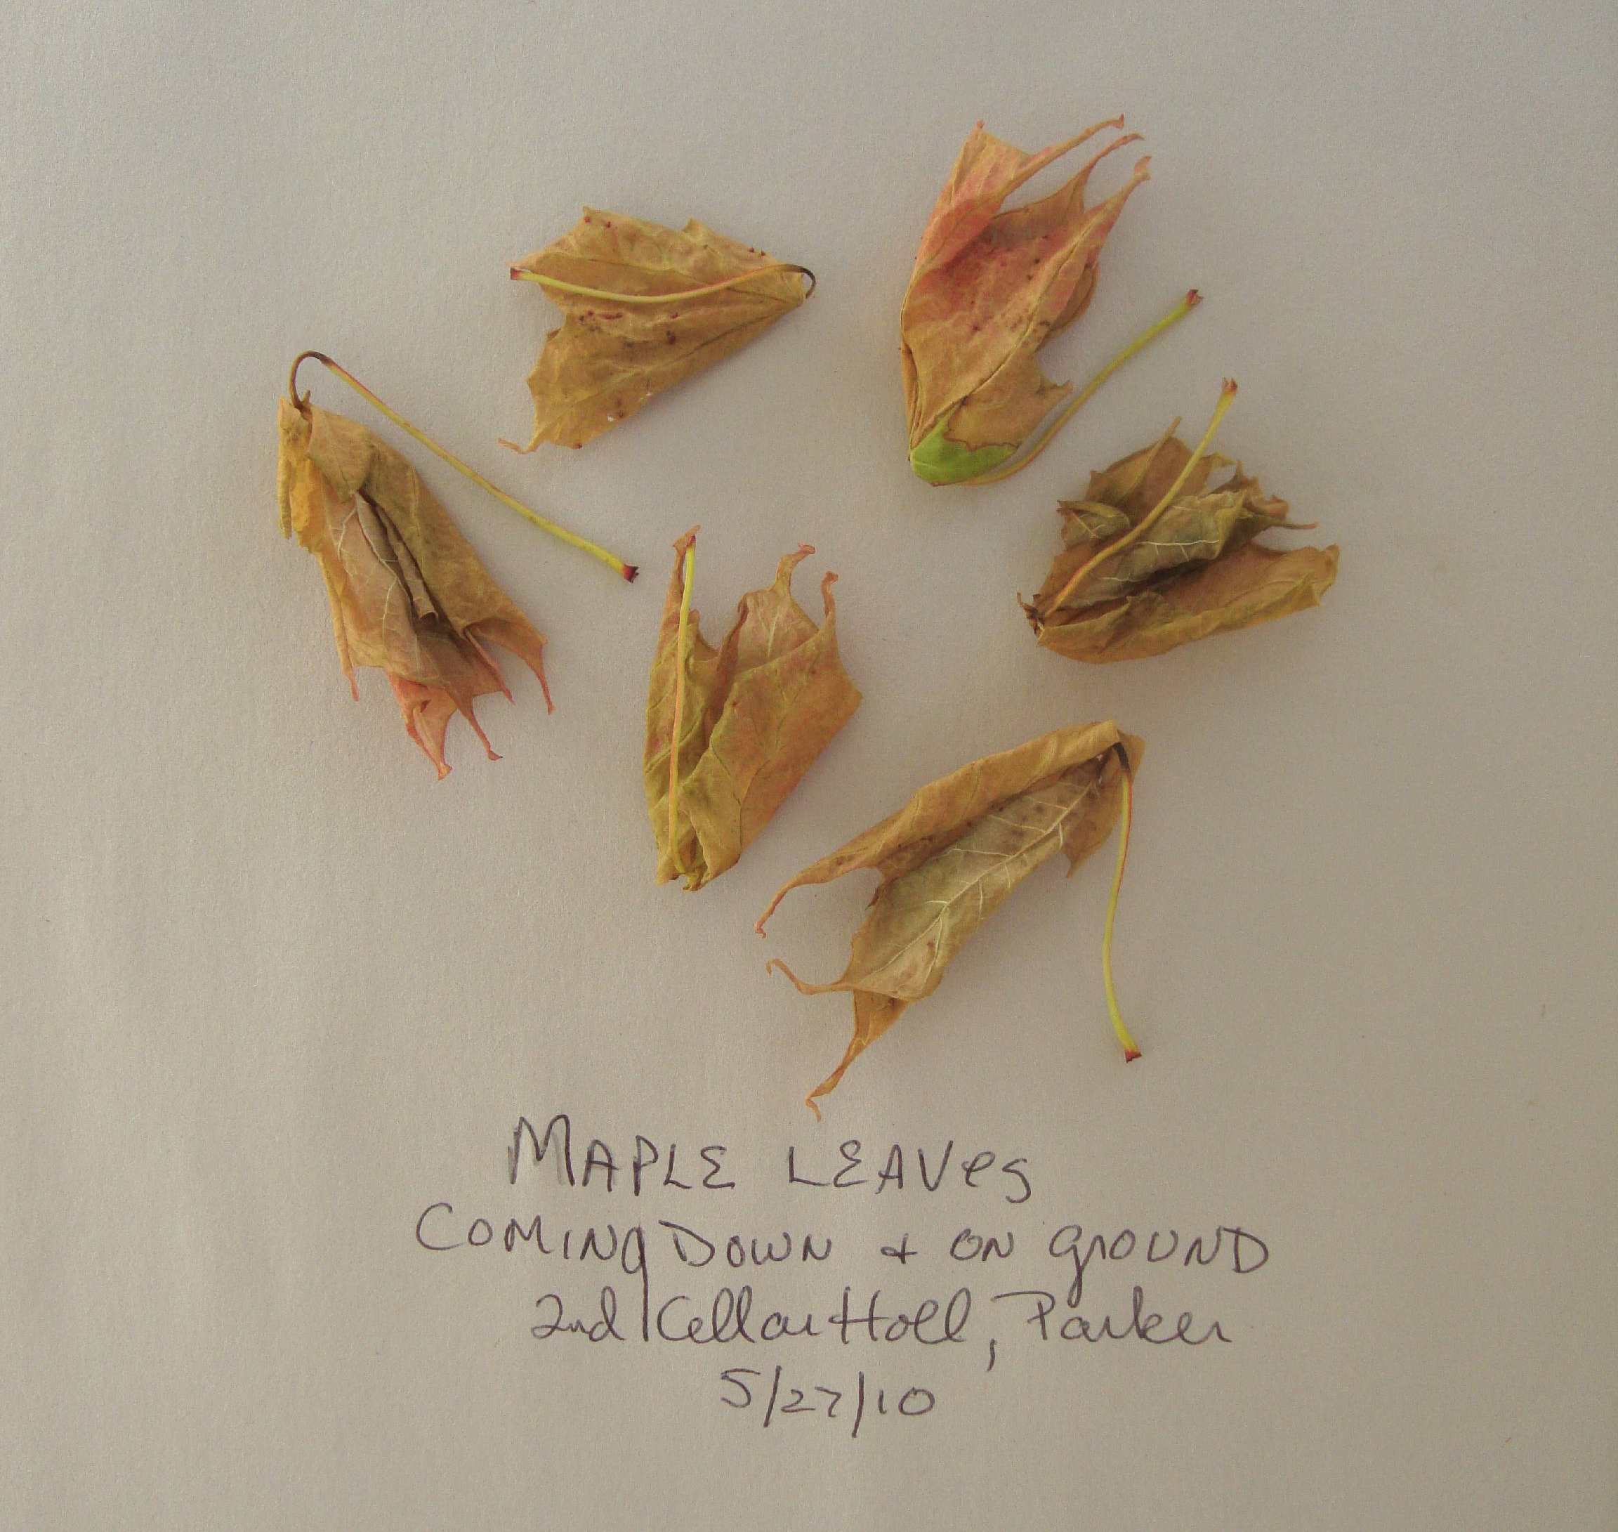
Acer saccharum defoliated
Totally brown leaves drop as we try to cut twig samples.

Slide 10
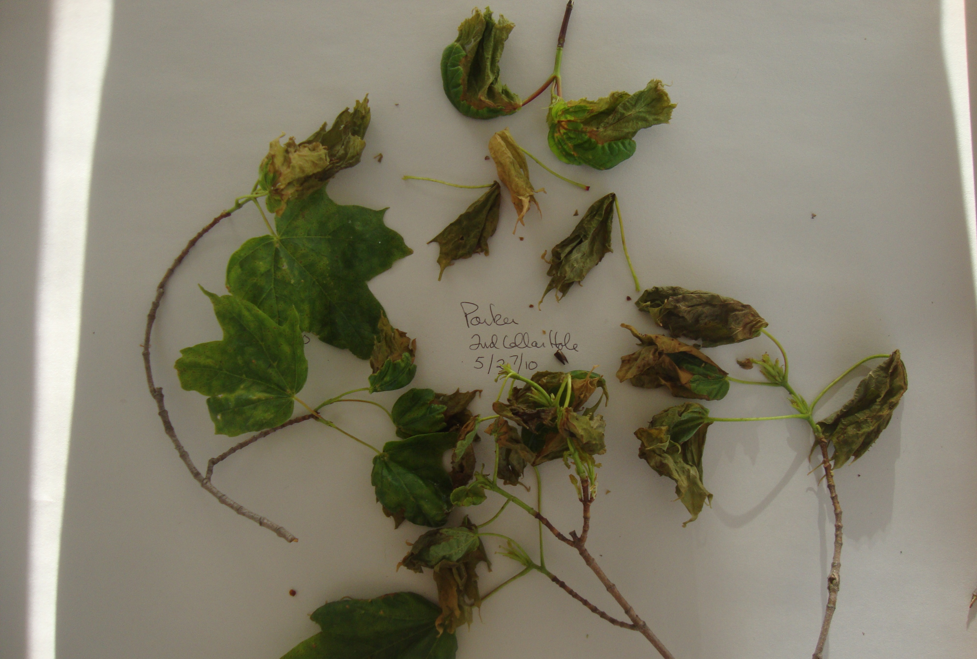
Damage Appears to be Fresh
Leaves seem to shrivel as we watch. Tender gold tips drying, green areas curling.

Slide 11
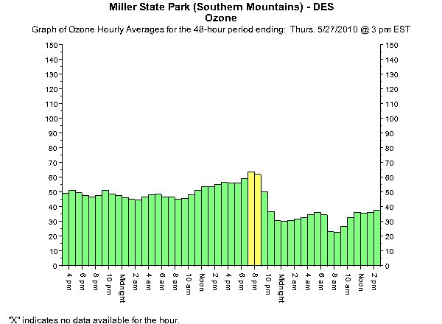
Ozone Levels High in the Connecticut Valley, West of the White Mts.

Slide 12
Fresh Paradermal Section
A quickly made section of a leaf shows damage at the tip and on the edge. Red pigment, possibly anthocyanin, appears to be spreading from stomate. Cell structures in red area are difficult to see. This appears to indicate a gas and one that attacks the underside of the leaf.

Slide 13
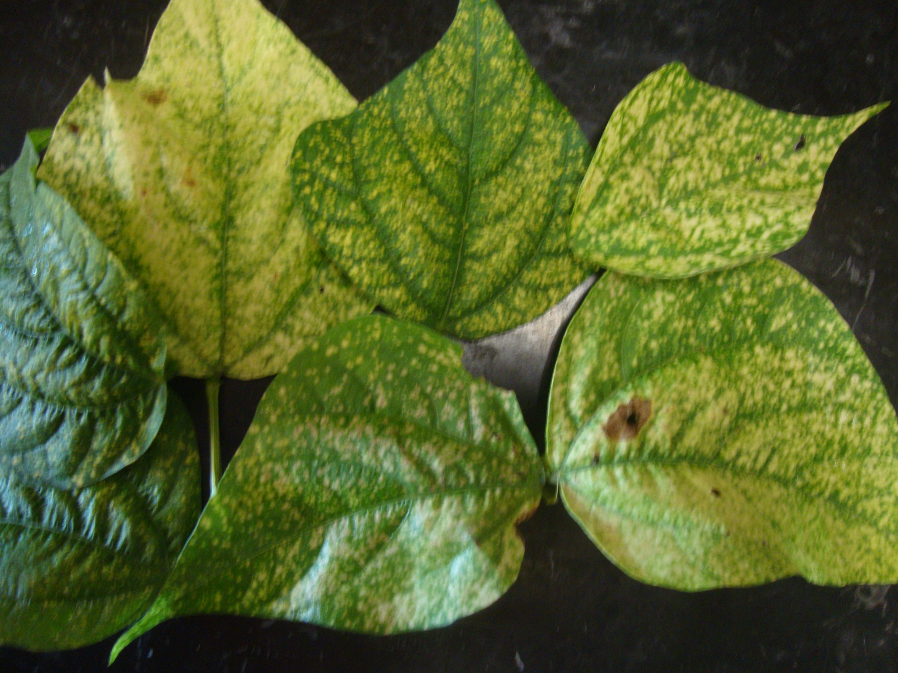
Could It Be Ozone? Frost?
Damage to string bean leaves at my farm matched on-line photos of ozone damage to deciduous leaves.
Frost generally rolls downhill.

Slide 14
A PAN Event? Peroxylacetyl nitrate.
Observed in the 1960s, Los Angeles.
Related to smog, high heat, Spring.
Difficult to measure in minute amounts in atmosphere.
Not considered by present EPA or WHO standards.
PAN damage recognized by “bronzing” of leaf and daamge to underside of leaf. Note burned stomates.

Slide 15
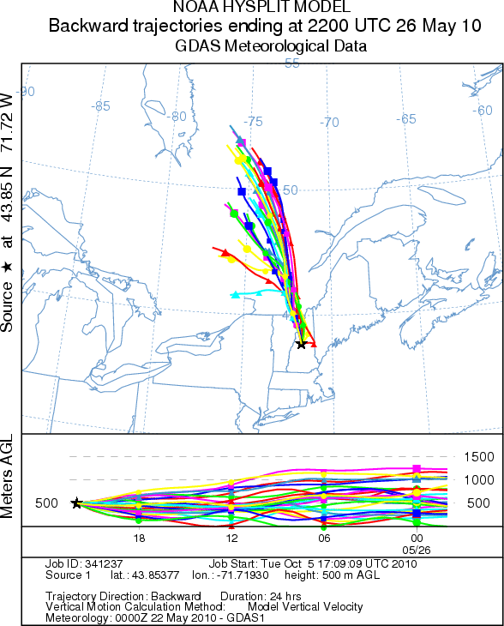
A Plume of Ingredients from Canada
Backward trajectories of air masses on May 26 show northerly winds from the area of Quebec where 86 forest fires were burning 199,000 ha. (SOPFEU). The smoke blew south to Campton at the same elevation as the maples

Slide 16
How Did the Leaves Respond?
Trees at 1st cellar hole, 1809 ft., retained damaged leaves. Trees at 2nd cellar hole, 1840 ft., retained a few first leaves but had vigorous releafing.

Slide 17
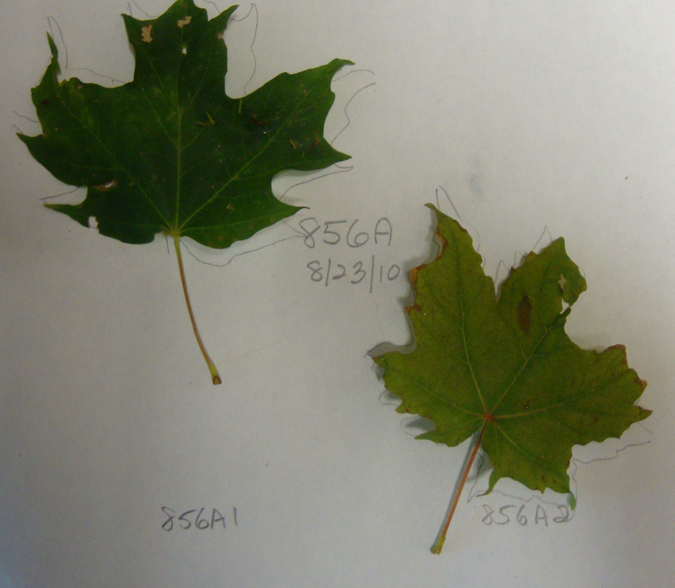
New Leaves Look Different
New leaves are much lighter green, containing less chlorophyll than older, damaged leaves.
New leaves were asymmetrical and had irregular edges and repeated shapes—as if they had been made too fast for proper reading of the RNA. patterns. Is this a mutation? Red maples, at sites even higher, showed extreme lateral budding, another possible malformation of cells.

Slide 18
New Leaves Behave Differently
Indices 1st 2nd
REIP 719.3 720.8
NDVI 0.873 0.824
TM5/4 0.614 0.652
NIR3/1 0.888 0.876
In May,leaves from 856 show a loss of chlorophyll and leaves from 856A show extreme senescence. One month later, retained leaves and new leaves show broad deep chlorophyll wells. Reflectance is lower and leaves show water stress but less senescence.

Slide 19
Damaged Yet Making Sugar
Despite grave damage, older leaves retained on trees at 1840 ft. show deep chlorophyll wells in late August.
Indices 856 856AOld 856ANew 856BOld 856New
REIP 705.4 725.4 703.8 730.1 723.9
NDVI 0.836 0.849 0.805 0.876 0.864
TM5/4 0.612 0.584 0.611 0.599 0.636
NIR3/1 0.916 0.939 0.944 0.888 0.906

Slide 20
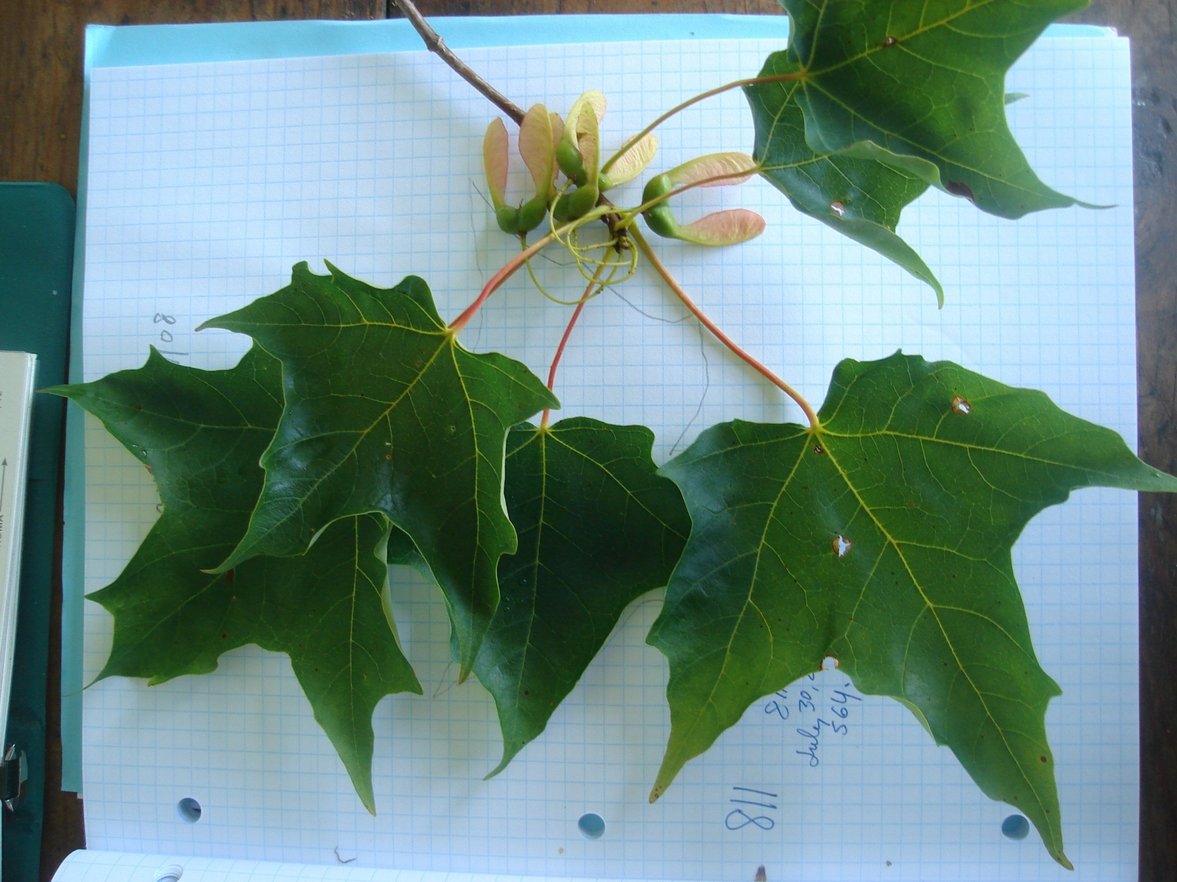
Teacher As Scientist
Science as “history?”
Or Science as inquiry, following the scientific method to an unknown answer.

Slide 21
What if A Teacher Were A Scientist?
Hypotheses
Science teachers who take on the role of scientist can convey central scientific skills and perspectives to students and inspire them to learn more science and even to become scientists.
A scientist teacher may also play a critical role in helping to prepare students and society for a great unknown such as climate change.
Teachers as scientists might electrify their classrooms, heat up their own interest and pleasure in teaching, and provide, with student help, valuable data, observations and analytical questions for the scientific community.

Slide 22
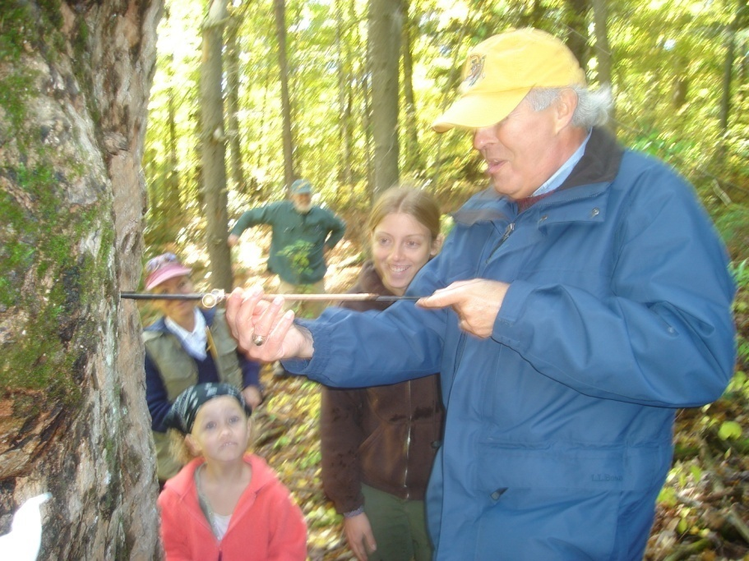
What’s in an Outreach Program?
The scientist
The teacher
The student
The scientist
The teacher
The student
A partnership.

Slide 23
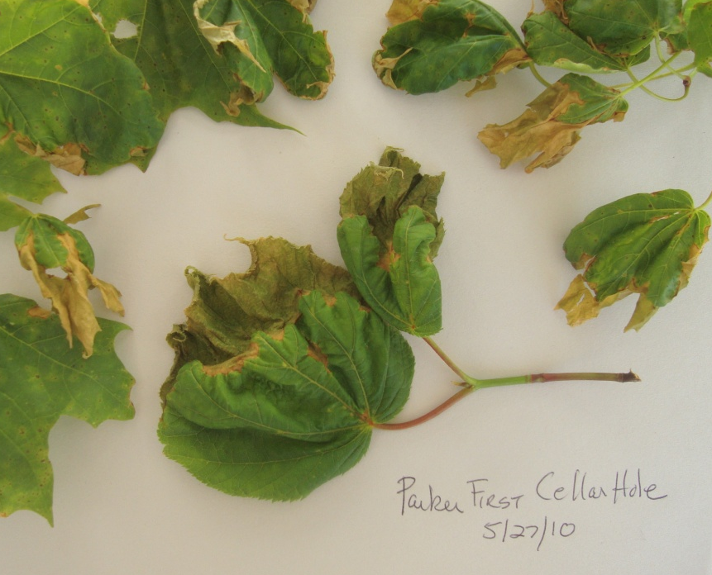
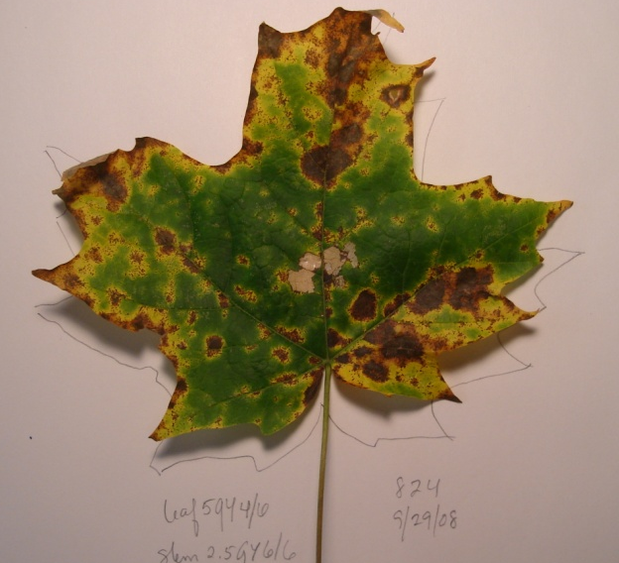
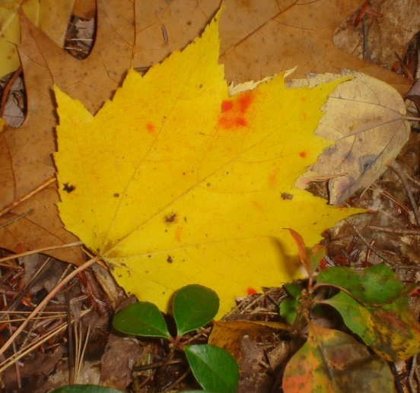
A New Branch on Forest Watch?
Prepare labs for school samples.
Build in time for classes to think, analyze.
Listen to what teachers see and think.

Slide 24
Lots to Consider. Lots to Research
Thank you.

